Slide 1
Lecture 16: Market Instruments in Practice
Prof. Austin
Environmental Economics Econ 4075

Slide 2
Roadmap
Market instruments in practice:
Quantities with Pigouvian taxes
Price formation in cap-and-trade
Cap-and-trade game
Prices vs. Quantities (Weitzman Rule)

Slide 3
Part 1: Quantities with Pigouvian Taxes

Slide 4
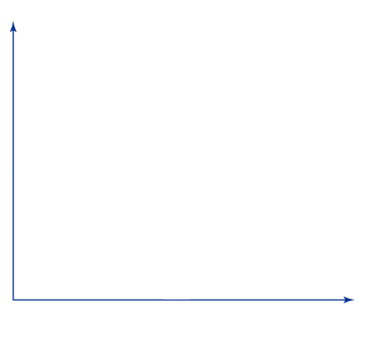


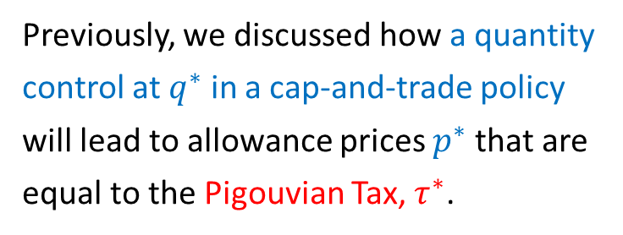
Recap from Last Time
Cost of
Abatement
Marginal
Costs of
Abatement
Previously, we discussed how a quantity control at $q^{∗}$ in a cap-and-trade policy will lead to allowance prices $p^{∗}$that are equal to the Pigouvian Tax, $τ^{∗}$.
${p^{∗}≡s}^{∗}≡τ^{∗}$
$q^{∗}$
Units of pollution abatement

Slide 5
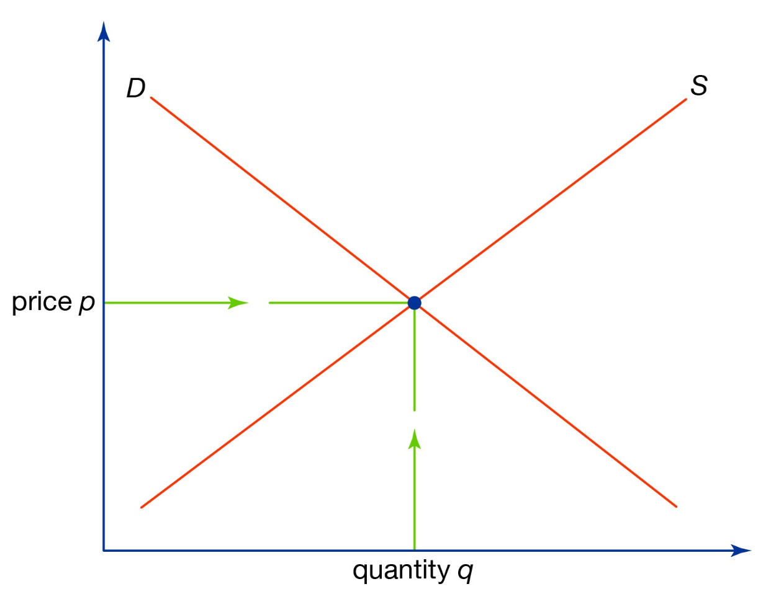
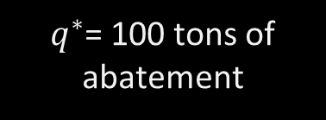
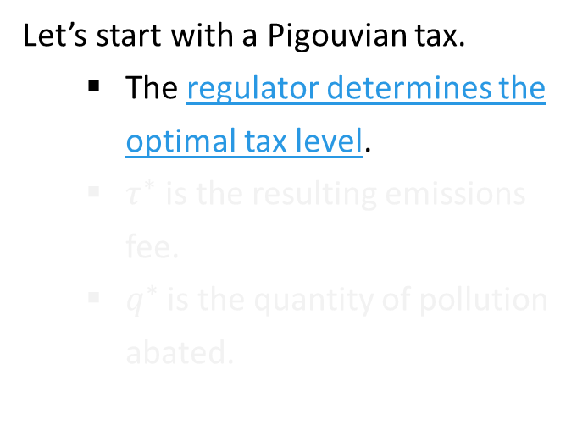

Quantities Under a Pigouvian Tax
Cost of
Abatement
Marginal
Costs
Let’s start with a Pigouvian tax.
The regulator determines the optimal tax level.
$τ^{∗}$ is the resulting emissions fee.
$q^{∗}$ is the quantity of pollution abated.
$$τ^{∗}=10\$ per ton$$
Marginal
Benefits
$q^{∗}$= 100 tons of abatement
Units of pollution abatement

Slide 6
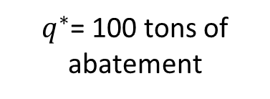
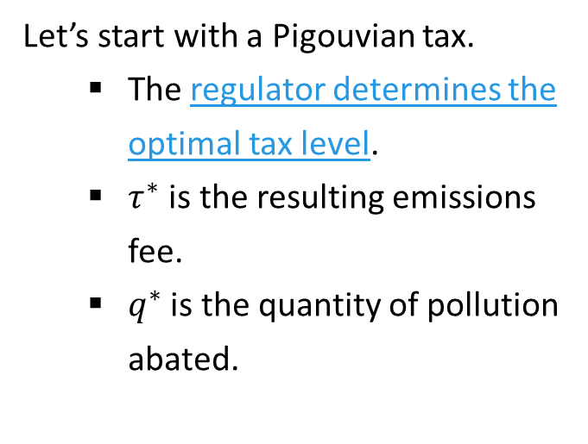

Quantities Under a Pigouvian Tax
Cost of
Abatement
Marginal
Costs
Let’s start with a Pigouvian tax.
The regulator determines the optimal tax level.
$τ^{∗}$ is the resulting emissions fee.
$q^{∗}$ is the quantity of pollution abated.
$$τ^{∗}=10\$ per ton$$
Marginal
Benefits
$q^{∗}$= 100 tons of abatement

Slide 7

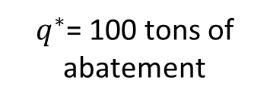

Marginal Costs Across Firms
Cost of
Abatement
In this example, the marginal cost of abatement curve represents the marginal costs across many polluting firms.
$$MC$$
$$τ^{∗}=10\$ per ton$$
$q^{∗}$= 100 tons of abatement

Slide 8


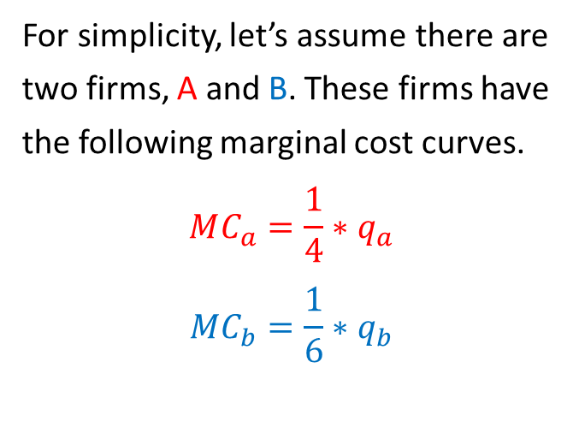
Marginal Costs Across Firms
Cost of
Abatement
For simplicity, let’s assume there are two firms, A and B. These firms have the following marginal cost curves.
$$MC_{a}=\frac{1}{4}∗q_{a}$$
$$MC_{b}=\frac{1}{6}∗q_{b}$$
$$MC_{a}$$
$$MC_{b}$$
$$MC$$
$$τ^{∗}=10\$ per ton$$
$q^{∗}$= 100 tons of abatement

Slide 9
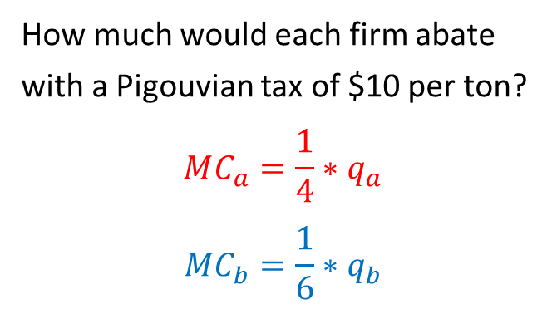
Quantities Under a Pigouvian Tax
Cost of
Abatement
How much would each firm abate with a Pigouvian tax of $10 per ton?
$$MC_{a}=\frac{1}{4}∗q_{a}$$
$$MC_{b}=\frac{1}{6}∗q_{b}$$
$$MC_{a}$$
$$MC_{b}$$
$$MC$$
$$τ^{∗}=10\$ per ton$$
$q^{∗}$= 100 tons of abatement

Slide 10



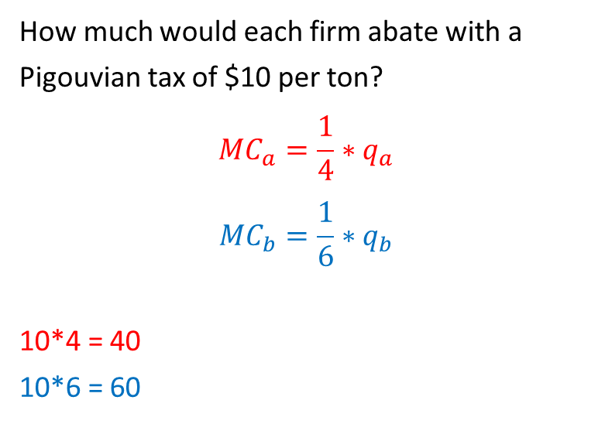


Quantities Under a Pigouvian Tax
Cost of
Abatement
How much would each firm abate with a Pigouvian tax of $10 per ton?
$$MC_{a}=\frac{1}{4}∗q_{a}$$
$$MC_{b}=\frac{1}{6}∗q_{b}$$
10*4 = 40
10*6 = 60
$$MC_{a}$$
$$MC_{b}$$
$$MC$$
$$τ^{∗}=10\$ per ton$$
$$40$$
$$60$$
$q^{∗}$= 100 tons of abatement

Slide 11
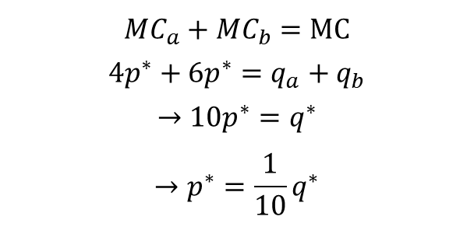
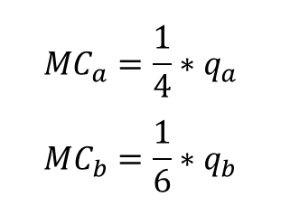
Quantities Under a Pigouvian Tax
Cost of
Abatement
We already know that the economy-wide abatement quantity will be 100 (60+40).
We can also re-construct the sector-wide marginal abatement cost curve.
$$MC_{a}$$
$$MC_{b}$$
$$MC$$
$$τ^{∗}=10\$ per ton$$
$$MC_{a}=\frac{1}{4}∗q_{a}$$
$$MC_{b}=\frac{1}{6}∗q_{b}$$
$$MC_{a}+MC_{b}=MC$$
$$4p^{∗}+6p^{∗}=q_{a}+q_{b}$$
$$→10p^{∗}=q^{∗}$$
$$→p^{∗}=\frac{1}{10}q^{∗}$$
$$40$$
$$60$$
$q^{∗}$= 100 tons of abatement

Slide 12
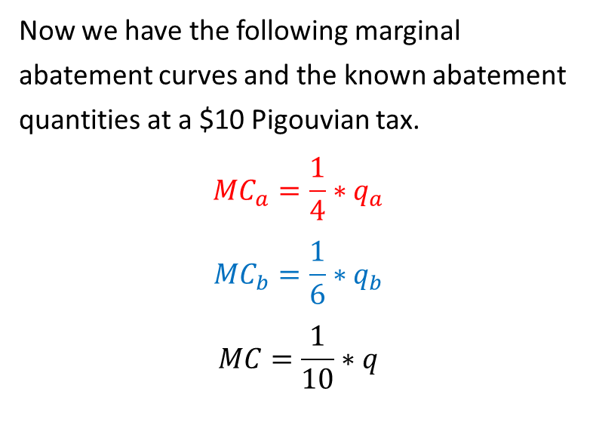
Quantities Under a Pigouvian Tax
Now we have the following marginal abatement curves and the known abatement quantities at a $10 Pigouvian tax.
$$MC_{a}=\frac{1}{4}∗q_{a}$$
$$MC_{b}=\frac{1}{6}∗q_{b}$$
$$MC=\frac{1}{10}∗q$$
Cost of
Abatement
$$MC_{a}$$
$$MC_{b}$$
$$MC$$
$$τ^{∗}=10\$ per ton$$
$$40$$
$$60$$
$q^{∗}$= 100 tons of abatement

Slide 13
Part 2: Price Formation in Cap and Trade

Slide 14
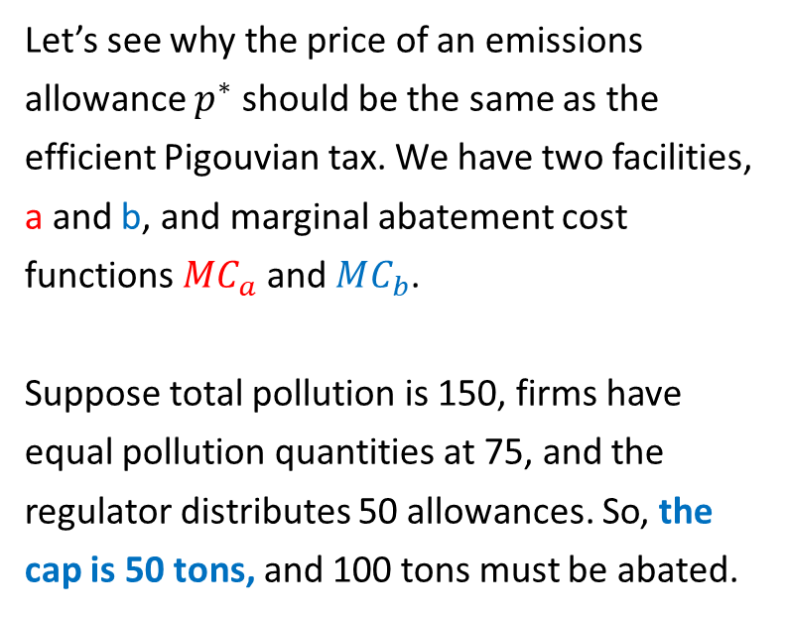


Allowance Price Formation in Cap and Trade
Let’s see why the price of an emissions allowance $p^{∗}$ should be the same as the efficient Pigouvian tax. We have two facilities, a and b, and marginal abatement cost functions $MC_{a}$ and $MC_{b}$.
Suppose total pollution is 150, firms have equal pollution quantities at 75, and the regulator distributes 50 allowances. So, the cap is 50 tons, and 100 tons must be abated.
Cost of
Abatement
$$MC_{a}$$
$$MC_{b}$$
$$MC$$
$p^{∗}$= $10 / ton
$$MB$$
$q^{∗}$= 100 tons of abatement

Slide 15



Allowance Price Formation in Cap and Trade
Area of A is the total cost of abatement for this firm at 40 units of abatement
Under the prior tax, A would have abated 40 units.
Abatement cost for the 40 units is 10*40/2 = $200.
Taxes paid on the remaining 35 units of pollution are $350.
Total cost of the policy for A is $550.
$$MC_{a}=\frac{1}{4}∗q$$
$p^{∗}$= $10 / ton
A
$$40$$
100 tons of abatement

Slide 16


Allowance Price Formation in Cap and Trade
Area of B is the total cost of abatement for this firm at 60 units of abatement
What about firm B? Under the prior tax:
Abatement cost for the 60 units is 10*60/2 = $300.
Taxes paid on the remaining 15 units of pollution are $150.
Total cost for B is $450.
$$MC_{b}=\frac{1}{6}∗q$$
B
100 tons of abatement
$$60$$

Slide 17
Allowance Price Formation in Cap and Trade
Area of A is the total cost of abatement for this firm at 40 units of abatement
Area of B is the total cost of abatement for this firm at 60 units of abatement
$$MC_{b}=\frac{1}{6}∗q$$
$$MC_{a}=\frac{1}{4}∗q$$
$p^{∗}$= $10 / ton
A
B
$$40$$
100 tons of abatement
$$60$$

Slide 18
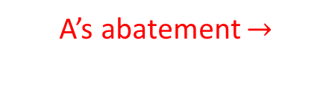



Allowance Price Formation in Cap and Trade
A’s Cost of
Abatement
B’s Cost of
Abatement
What are abatement costs if the firms each have 25 allowances and do not trade?
A’s abatement $→$
$$50$$
$←$B’s abatement
$$100$$
$$100$$

Slide 19
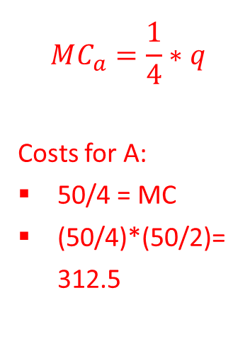

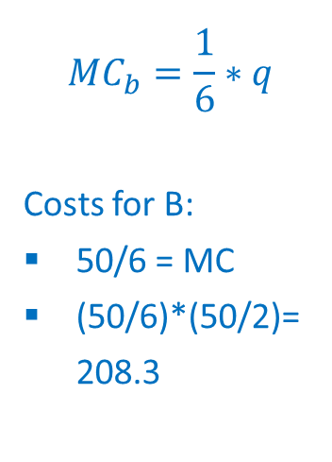
Allowance Price Formation in Cap and Trade
A’s Cost of
Abatement
B’s Cost of
Abatement
$$MC_{a}=\frac{1}{4}∗q$$
Costs for A:
50/4 = MC
(50/4)*(50/2)=312.5
$$MC_{b}=\frac{1}{6}∗q$$
Costs for B:
50/6 = MC
(50/6)*(50/2)=208.3
$$50/4$$
A
B
A’s abatement $→$
$$50$$
$←$B’s abatement
$$100$$
$$100$$

Slide 20
Allowance Price Formation in Cap and Trade
Cost of
Abatement
How could abatement be assigned to minimize costs?
$$100$$
$$50$$
$$100$$

Slide 21
Allowance Price Formation in Cap and Trade
Cost of
Abatement
Avoided abatement costs.
How could abatement be assigned to minimize costs?
$$MC_{a}=MC_{b}$$
$10 / ton
A
B
$$40, 60$$
$$100$$
$$50$$
$$100$$

Slide 22
Allowance Price Formation in Cap and Trade
Cost of
Abatement
How can the firms trade to reach this efficient least-cost point?
$$MC_{a}=MC_{b}$$
$10 / ton
A
C
B
$$40, 60$$
$$100$$
$$50$$
$$100$$

Slide 23
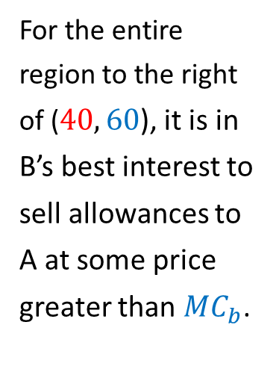
Allowance Price Formation in Cap and Trade
Cost of
Abatement
For the entire region to the right of ($40, 60$), it is in B’s best interest to sell allowances to A at some price greater than $MC_{b}$.
$$MC_{a}=MC_{b}$$
$10 / ton
A
C
B
$$40, 60$$
$$100$$
$$50$$
$$100$$

Slide 24
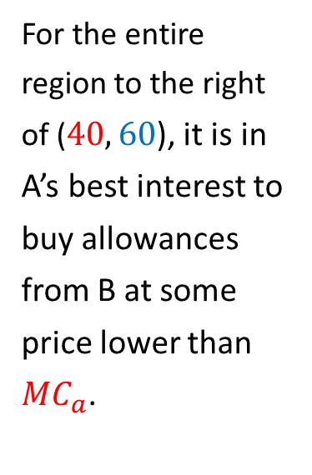
Allowance Price Formation in Cap and Trade
Cost of
Abatement
For the entire region to the right of ($40, 60$), it is in A’s best interest to buy allowances from B at some price lower than $MC_{a}$.
$$MC_{a}=MC_{b}$$
$10 / ton
A
C
B
$$40, 60$$
$$100$$
$$50$$
$$100$$

Slide 25


Allowance Price Formation in Cap and Trade
Cost of
Abatement
How will these firms trade:
If each firm is assigned 25 pollution allowances?
If A is assigned all 50 pollution allowances?
If B is assigned all 50 pollution allowances?
$10 / ton
A
C
B
$$40, 60$$
$$100$$
$$100$$
$$50$$

Slide 26
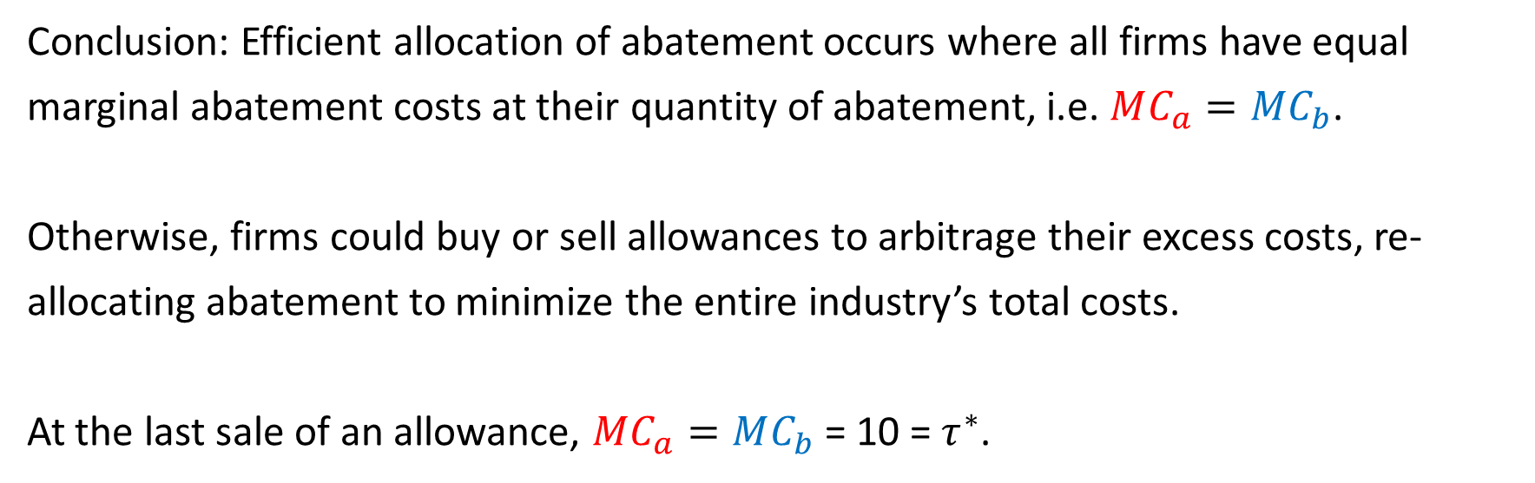
Allowance Price Formation in Cap and Trade
Conclusion: Efficient allocation of abatement occurs where all firms have equal marginal abatement costs at their quantity of abatement, i.e. $MC_{a}=MC_{b}$.
Otherwise, firms could buy or sell allowances to arbitrage their excess costs, re-allocating abatement to minimize the entire industry’s total costs.
At the last sale of an allowance, $MC_{a}=MC_{b}$ = 10 = $τ^{∗}$.

Slide 27
Quick Caveat on Price Formation
Cost of
Abatement
What about this region?
Short aside:
With equal allowance allotments at 25, B could charge A $10 for their 10 allowances and actually make revenue from the sales.
Total cost of abatement would still be minimized, but B is made better off by these trades.
We’ll return to this later today.
$10 / ton
A
B
$$100$$
$$50$$
$$100$$

Slide 28
Part 3: For Want of A Chair

Slide 29
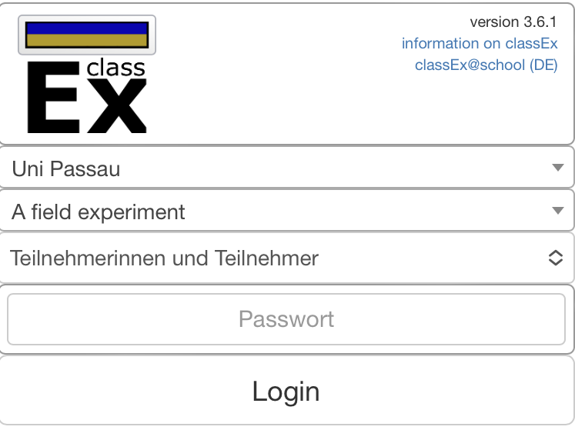
For Want of a Chair:
How to Play
Please navigate to the following web-page:
https://classEx.uni-passau.de
2. Type in “Environmental Protection Agency”
3. Enter the password: m5GK

Slide 30
For Want of a Chair:
How it Works
Each of you is now a polluting facility, and each chair represents one allowance to pollute.
We will play musical chairs to determine the initial allowance of pollution across firms.
If you have a chair, you have an allowance to pollute. If you are standing, then you have abated your pollution at some cost that is unique to you.

Slide 31
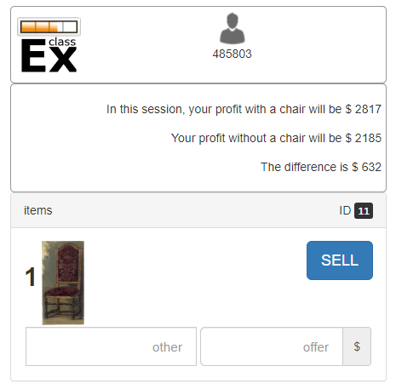
For Want of a Chair:
How it Works
If you are seated, you may want to sell your right to pollute if the allowance sale price is greater than your cost of abating.
For player 11, the cost of abatement is $632. They are better off selling their seat if:
Sale Price > $632

Slide 32
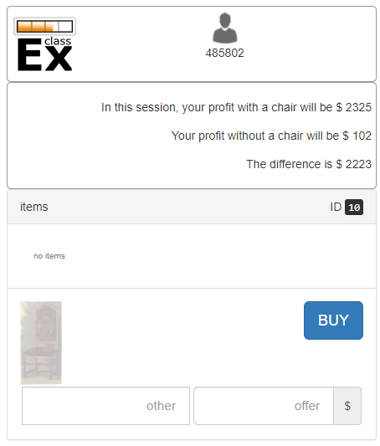
For Want of a Chair:
How it Works
If you are standing, you may want to buy the right to sit if the offer price for a pollution allowance is less than the cost of abating.
For player 10, the cost of abatement is $2,223. They are better off purchasing a seat if:
Purchase Price < $2,223

Slide 33

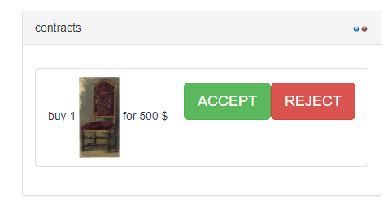
For Want of a Chair:
How it Works
If you are sitting and you want to sell your pollution allowance (i.e., chair), you need to figure out the other player’s ID number and send them an offer.
They then have the option to accept your offer.

Slide 34
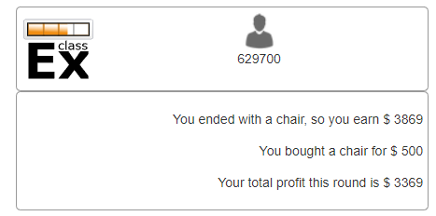
For Want of a Chair:
How it Works
Keep track of your total profit and sum it across rounds. The top three players will receive a prize.

Slide 35
Part 4: Prices vs. Quantities

Slide 36
Equivalence between Pigouvian Taxes and Quantity Controls
We spent the first part of class showing how emissions taxes and cap-and-trade systems have theoretical similarities. Specifically:
Emissions taxes (or abatement subsidies) set the price of pollution and push firms to the optimal quantity of abatement.
Cap-and-trade set the quantity of pollution, and the price of an allowance is pushed to the marginal cost of abatement at that quantity through trades.
In theory, the quantity and price of pollution abatement is equivalent in both systems.

Slide 37
How Pigouvian Taxes and Quantity Controls Differ
Two key differences:
Tax revenue (or subsidy cost) vs. allowance value.
When the abatement cost curve is not known with certainty, the quantity reduced and the marginal cost of abatement at that quantity are not the same for each regulatory instrument.

Slide 38

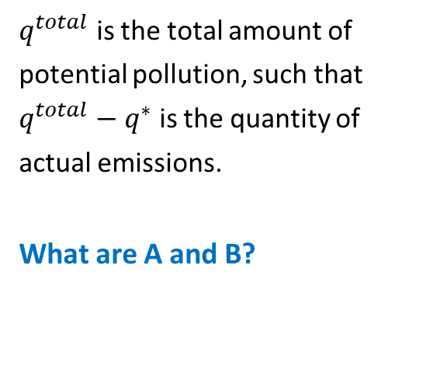


1) Tax Revenue vs. Allowance Value
Cost of
Abatement
Marginal
Costs of
Abatement
$q^{total}$ is the total amount of potential pollution, such that $q^{total}−q^{∗}$ is the quantity of actual emissions.
What are A and B?
$$p∗$$
A
B
$$q^{∗}$$
$$q^{total}$$

Slide 39
1) Tax Revenue vs. Allowance Value
Cost of
Abatement
Marginal
Costs of
Abatement
What are A and B?
The area of A is total abatement cost.
The area of B is the tax revenue or the value of allowances.
In cap-and-trade, can recoup B through an allowance auction or assign allowances for equity.
$$p∗$$
A
B
$$q^{∗}$$
$$q^{total}$$

Slide 40
2) Prices vs. Quantities
When the abatement cost curve is not known with certainty, the quantity reduced and the marginal cost of abatement at that quantity are not the same for each regulatory instrument (setting prices vs. setting quantities).
Why might industry-wide marginal abatement costs not be known with certainty?

Slide 41


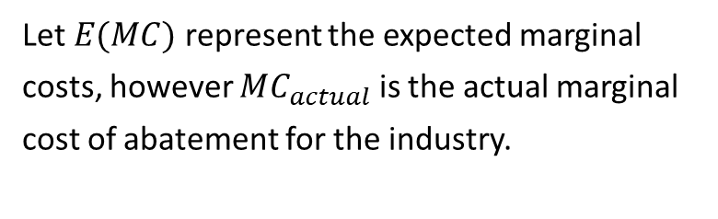



2) Prices vs. Quantities
$$MC_{actual}$$
Let $E(MC)$ represent the expected marginal costs, however $MC_{actual}$ is the actual marginal cost of abatement for the industry.
$$E(MC)$$
$$p^{∗}$$
$$MB$$
$$q^{∗}$$
Quantity of
Abatement

Slide 42
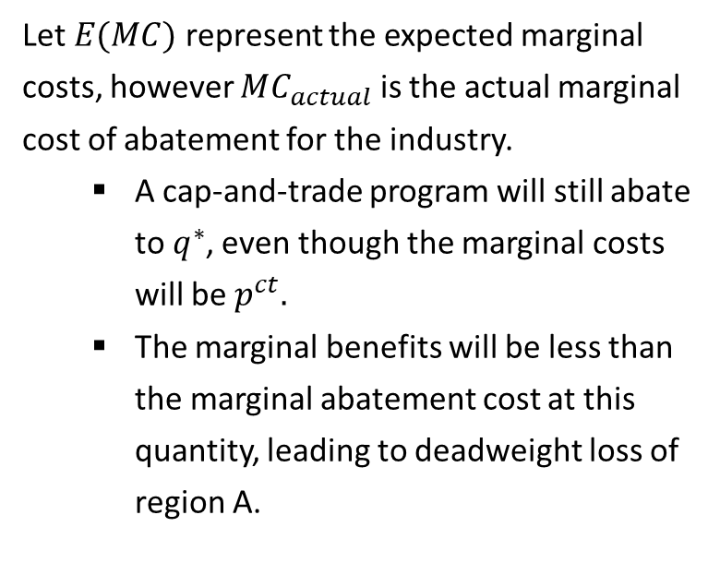

2) Prices vs. Quantities
$$MC_{actual}$$
Let $E(MC)$ represent the expected marginal costs, however $MC_{actual}$ is the actual marginal cost of abatement for the industry.
A cap-and-trade program will still abate to $q^{∗}$, even though the marginal costs will be $p^{ct}.$
The marginal benefits will be less than the marginal abatement cost at this quantity, leading to deadweight loss of region A.
$$E(MC)$$
$$p^{ct}$$
A
$$p^{∗}$$
$$MB$$
$$q^{∗}$$
Quantity of
Abatement

Slide 43

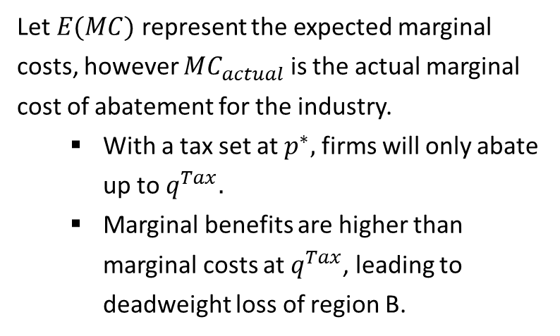
2) Prices vs. Quantities
$$MC_{actual}$$
Let $E(MC)$ represent the expected marginal costs, however $MC_{actual}$ is the actual marginal cost of abatement for the industry.
With a tax set at $p^{∗},$ firms will only abate up to $q^{Tax}.$
Marginal benefits are higher than marginal costs at $q^{Tax}$, leading to deadweight loss of region B.
$$E(MC)$$
$$p^{ct}$$
A
B
$$p^{∗}$$
$$MB$$
$$q^{Tax}$$
$$q^{∗}$$
Quantity of
Abatement

Slide 44
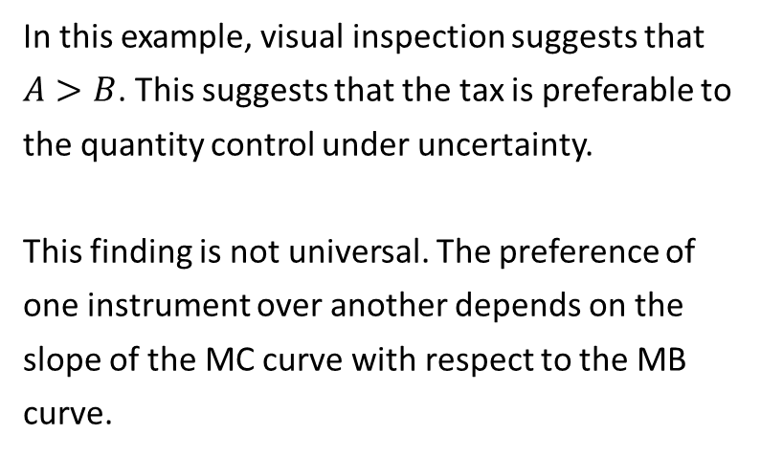

2) Prices vs. Quantities
$$MC_{actual}$$
In this example, visual inspection suggests that $A>B$. This suggests that the tax is preferable to the quantity control under uncertainty.
This finding is not universal. The preference of one instrument over another depends on the slope of the MC curve with respect to the MB curve.
$$E(MC)$$
$$p^{cp}$$
A
B
$$p^{∗}$$
$$MB$$
$$q^{Tax}$$
$$q^{∗}$$
Quantity of
Abatement

Slide 45







2) Prices vs. Quantities
Let’s look at another example where the slopes of MB vs. MC have different magnitude.
Here, we can observe that B>A, and hence in this situation we would prefer a quantity control to a tax.
$$MC_{actual}$$
B
$$p^{cp}$$
A
$$E(MC)$$
$$p^{∗}$$
$$MB$$
$$q^{Tax}$$
$$q^{∗}$$
Quantity of
Abatement

Slide 46

2) Prices vs. Quantities
$$MC_{actual}$$
The Weitzman Rule
When marginal costs are uncertain, a tax instrument is preferred:
If the absolute value of the slope of MC > MB (i.e., MB is flatter).
A quantity instrument is preferred:
If the absolute value of the slope of MB > MC (i.e., MC is flatter).
$$E(MC)$$
$$p^{cp}$$
A
B
$$p^{∗}$$
$$MB$$
$$q^{Tax}$$
$$q^{∗}$$
Quantity of
Abatement

Slide 47
Next class
Next class will cover the Clean Air Act. We’ll discuss the background of the regulation and how it works, cover a cap-and-trade system in Southern California, and discuss some prominent papers on the topic.
Your third case study is due Sunday, 10/29.
Materials for Wednesday:
Hernandez-Cortes, Meng, and Weber (2022)
(optional) Chay and Greenstone (2005)

Slide 48

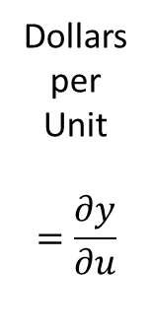
Recall Optimal Quantity
Total Benefits and Total Costs
Marginal Benefits and Marginal Costs
Total
Benefit
Dollars
per
Unit
$$=\frac{∂y}{∂u}$$
Marginal
Costs
Dollars
= $Y$
Total
Costs
Marginal
Benefit
Units of pollution abatement
Units of pollution abatement

Slide 49
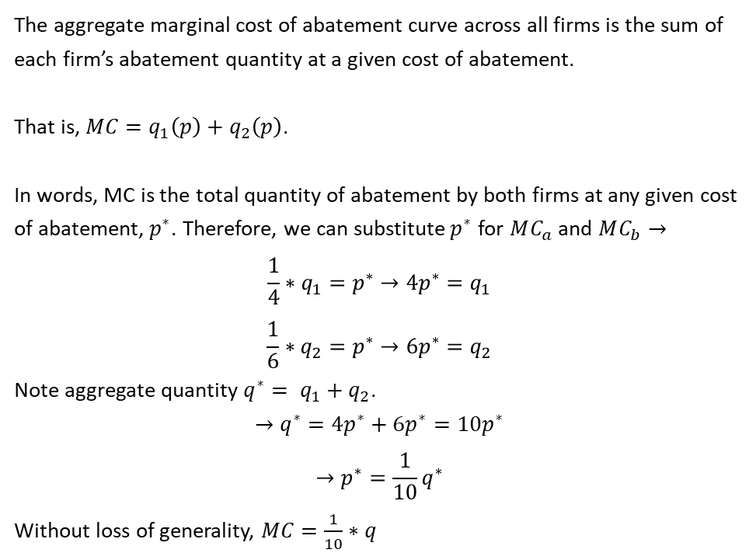


Proof $MC=\frac{1}{10}∗q$
The aggregate marginal cost of abatement curve across all firms is the sum of each firm’s abatement quantity at a given cost of abatement.
That is, $MC=q_{1}\left(p\right)+q_{2}\left(p\right)$.
In words, MC is the total quantity of abatement by both firms at any given cost of abatement,${ p}^{∗}$. Therefore, we can substitute${ p}^{∗}$ for $MC_{a}$ and $MC_{b}→$
$$\frac{1}{4}∗q_{1}=p^{∗}→4p^{∗}=q_{1}$$
$$\frac{1}{6}∗q_{2}=p^{∗}→6p^{∗}=q_{2}$$
Note aggregate quantity ${q^{∗}= q}_{1}+q_{2}$.
$$→q^{∗}=4p^{∗}+6p^{∗}=10p^{∗}$$
$$→p^{∗}=\frac{1}{10}q^{∗}$$
Without loss of generality, $MC=\frac{1}{10}∗q$
$$MC_{a}$$
$$MC_{b}$$
$$MC$$
$$p^{∗}$$
$$MB$$
$$40$$
$$60$$
$q^{∗}$= 100 tons of abatement

